Slide 1

IBM CLOUD
OpenShift on VMware
(VCS Add-on)
Vann Lam
Last update: 2021-12-14
© 2021 IBM Corporation
Notes:
Author: lionel.mace@fr.ibm.com, vann.lam@fr.ibm.com

Slide 2
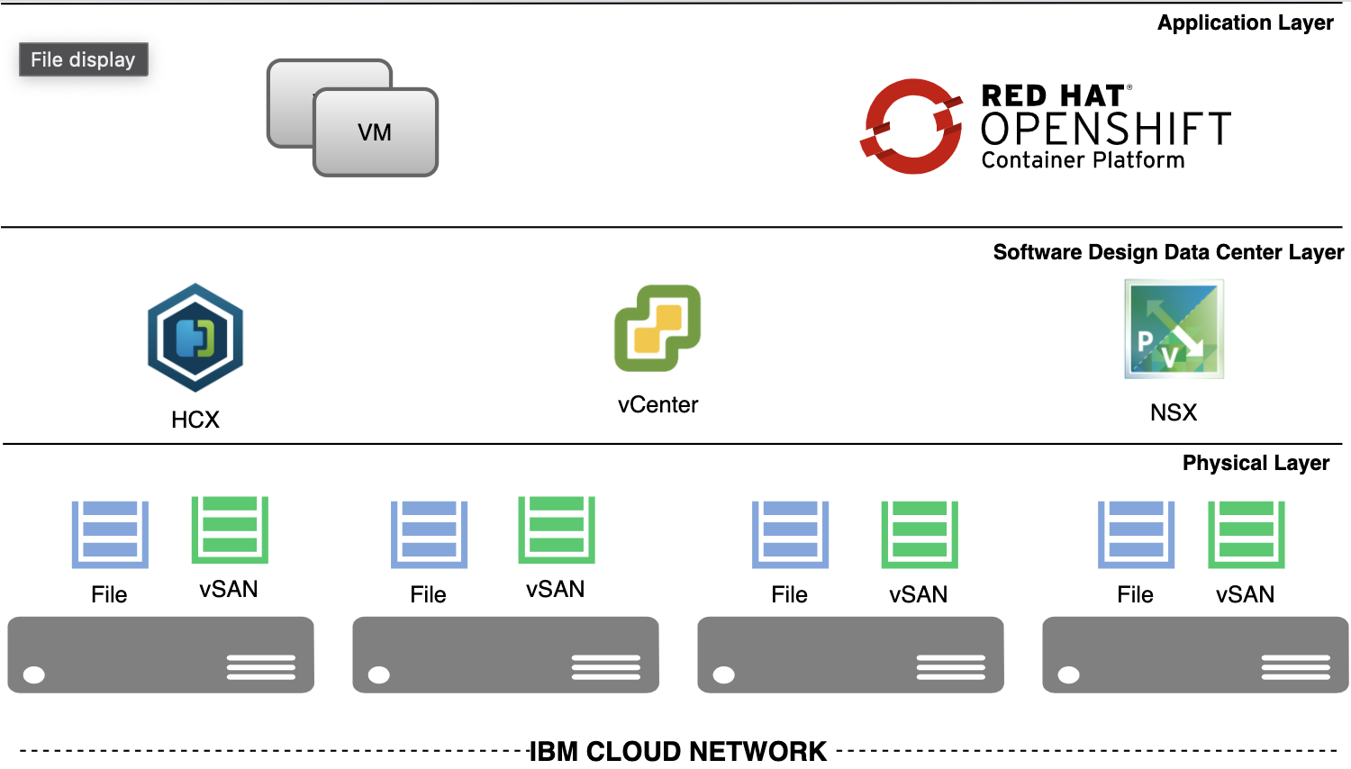
VMware Solutions and OpenShift
https://cloud.ibm.com/docs/vmwaresolutions?topic=vmwaresolutions-openshift-runbook-runbook-intro

Slide 3
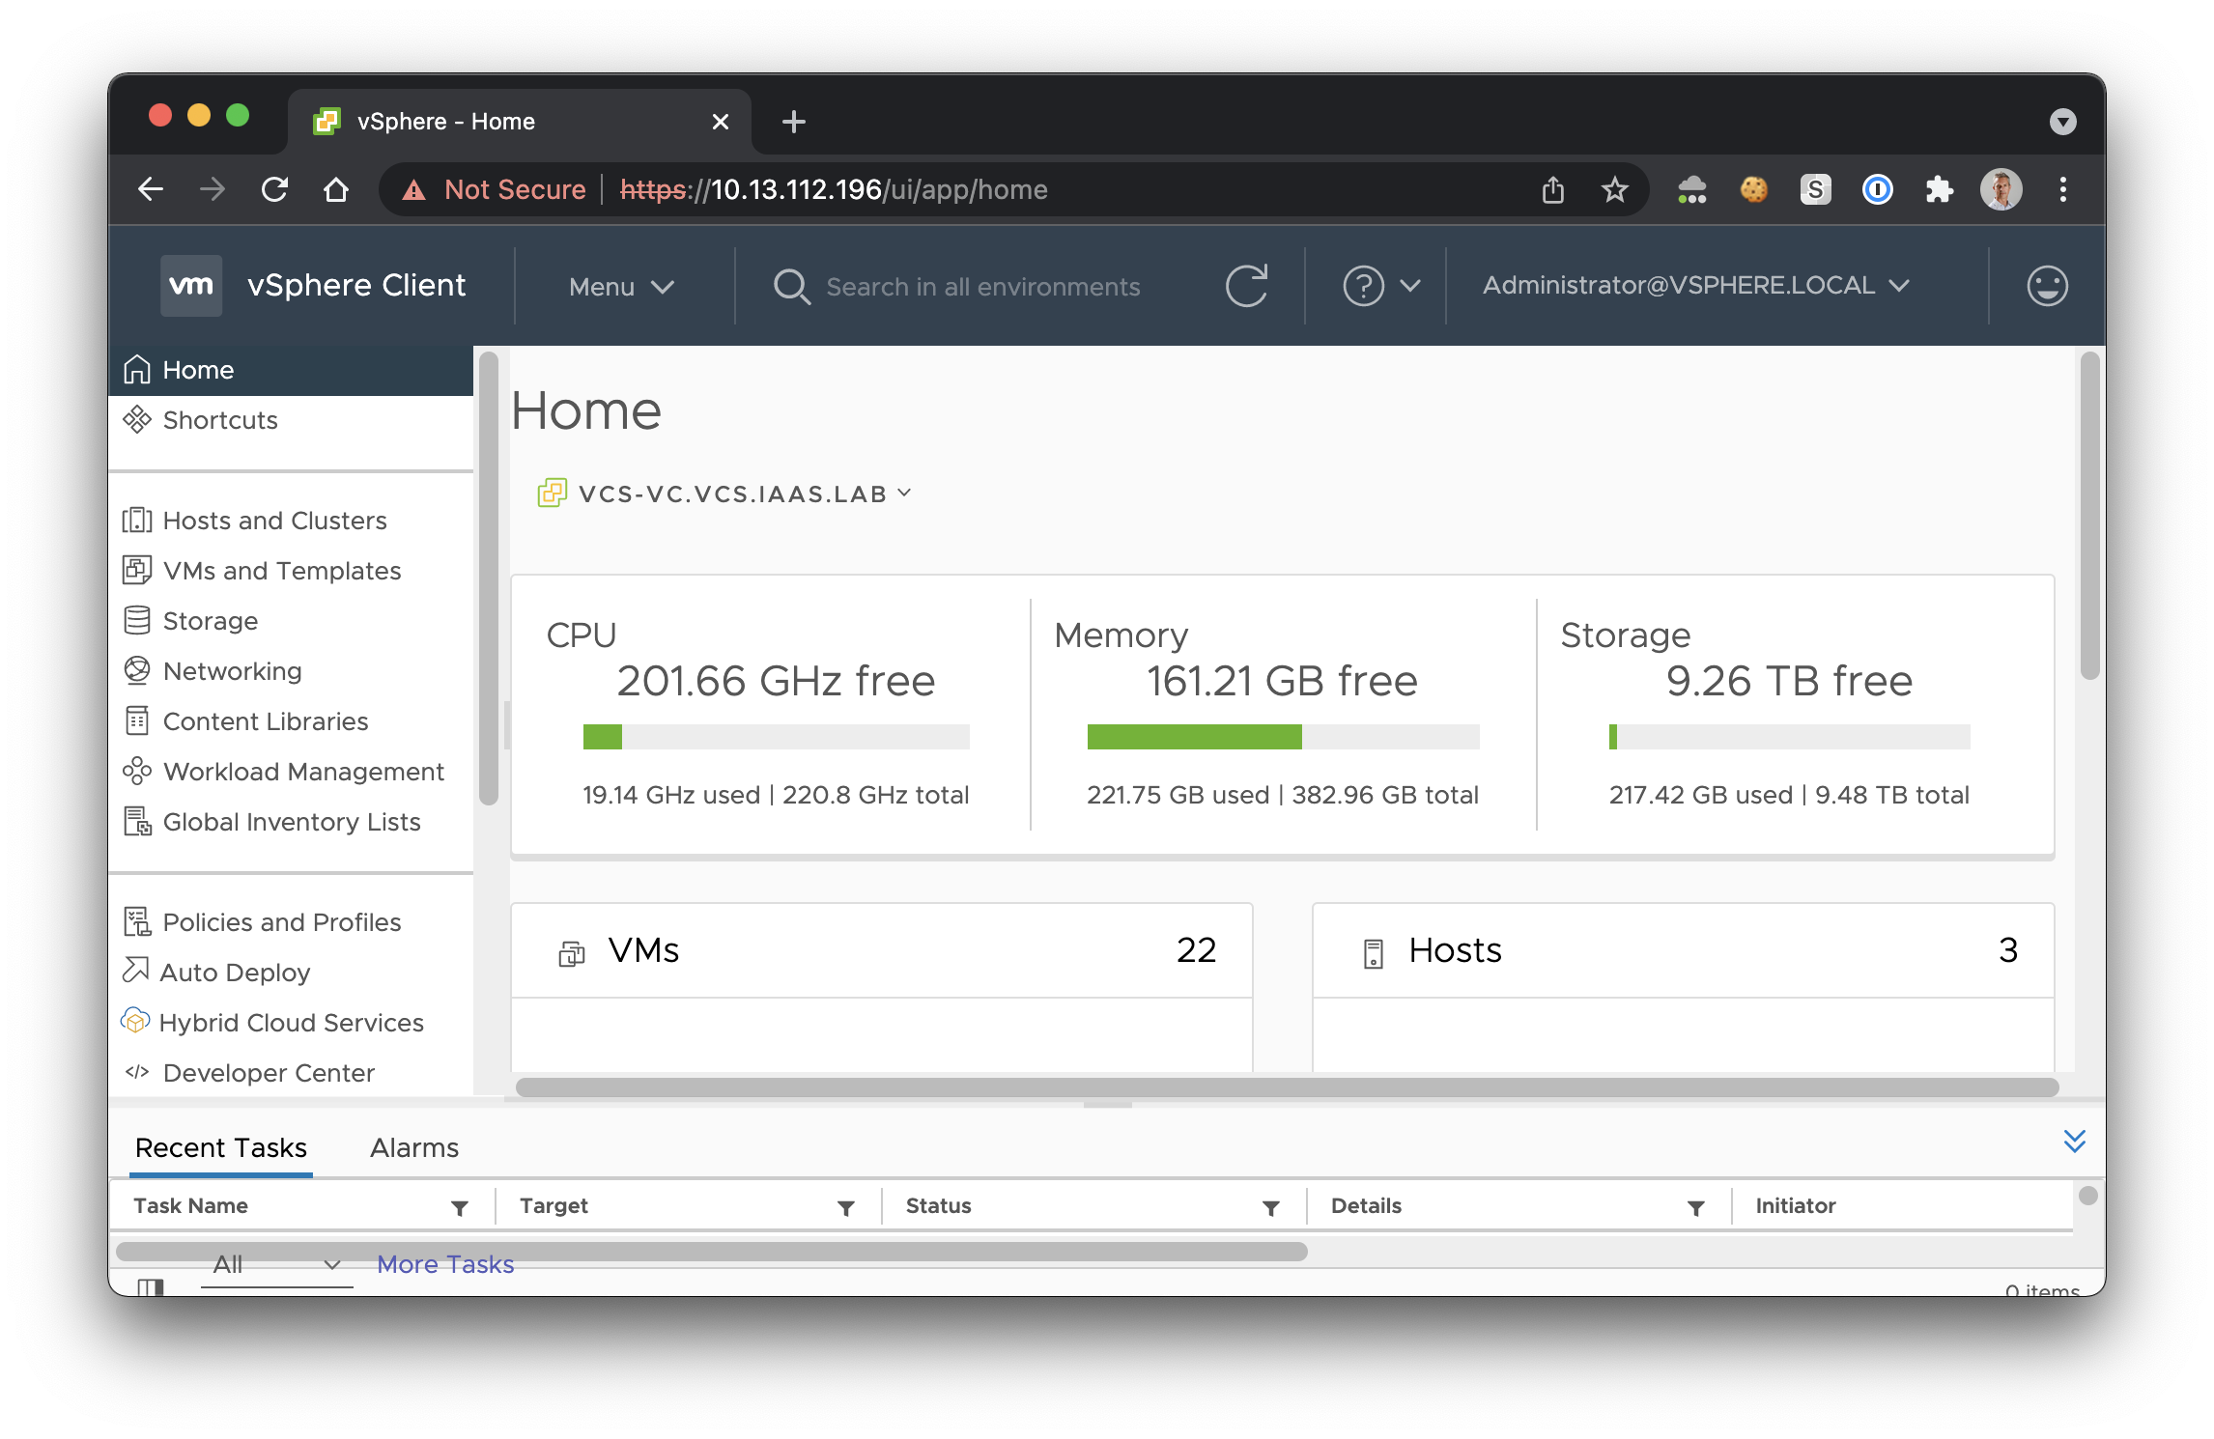
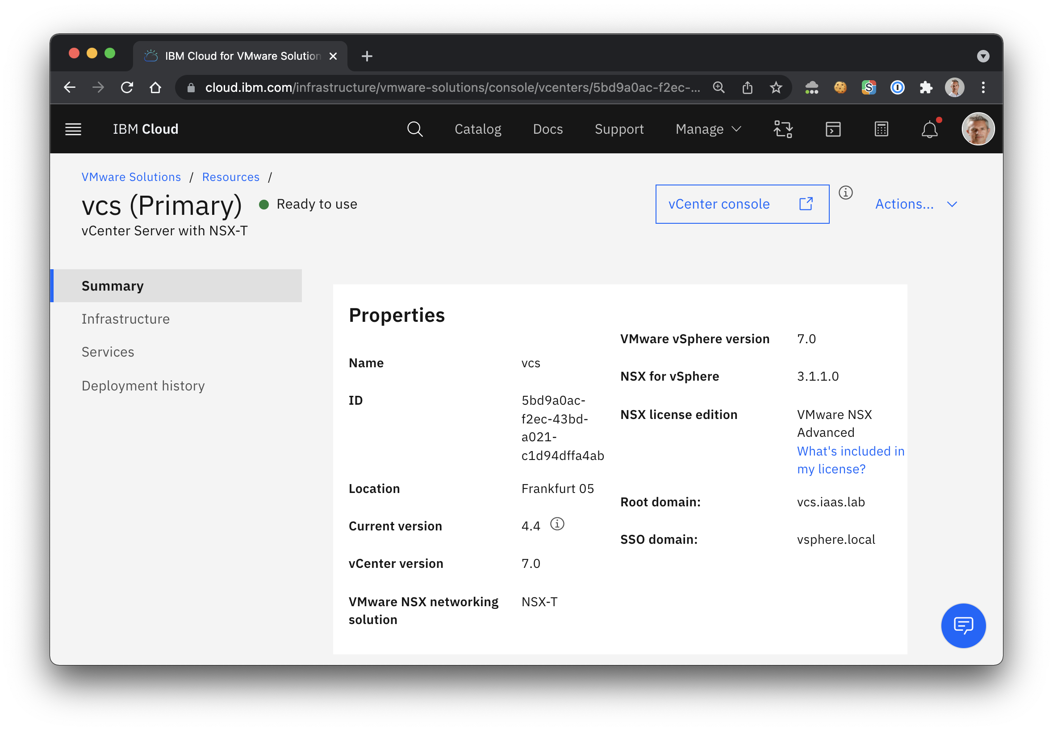
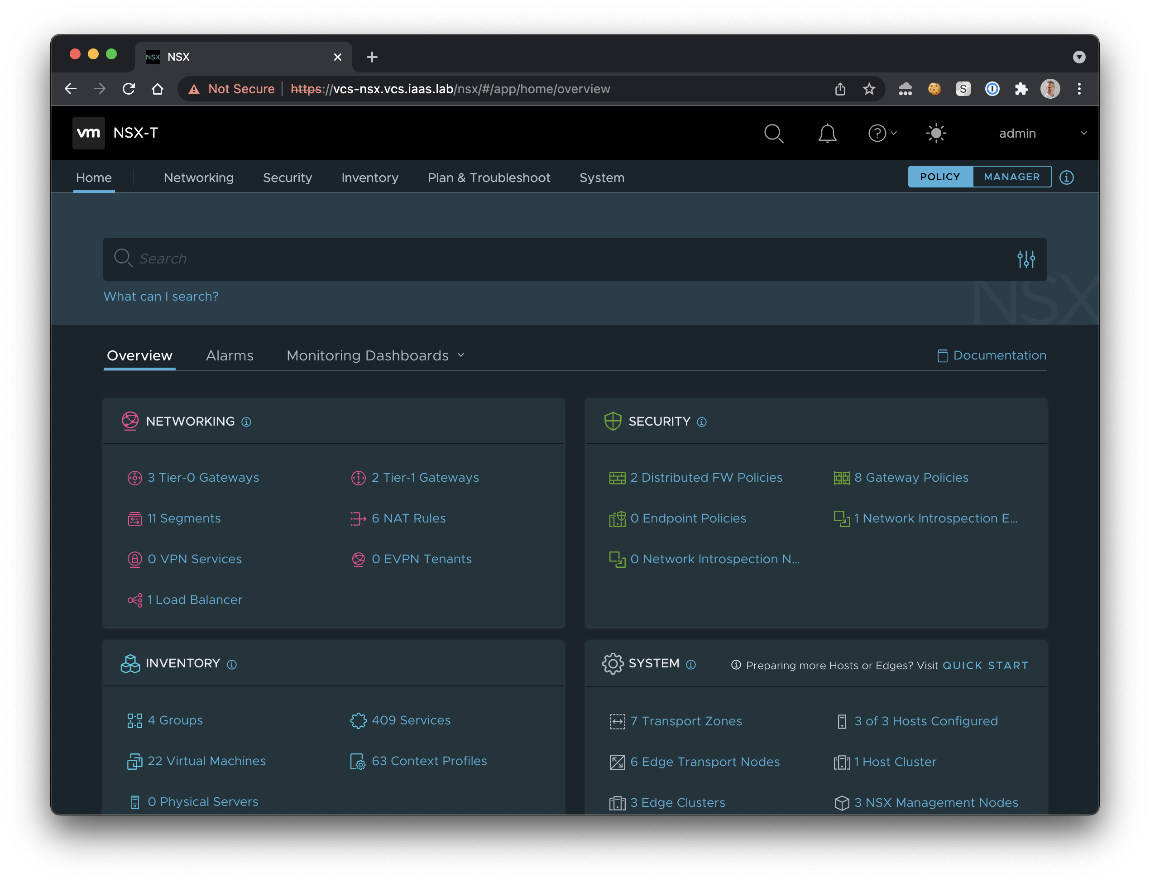
Existing VCS Cluster
https://cloud.ibm.com/infrastructure/vmware-solutions/console/vcenters

Slide 4
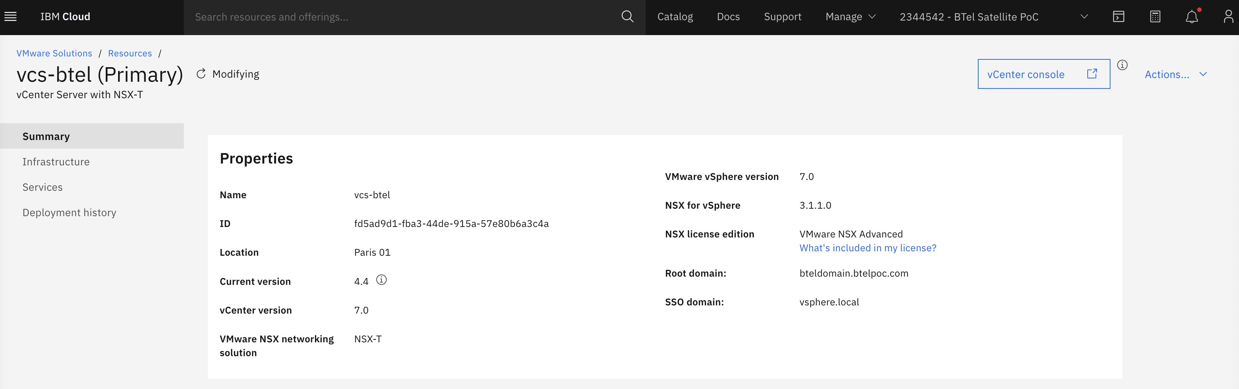
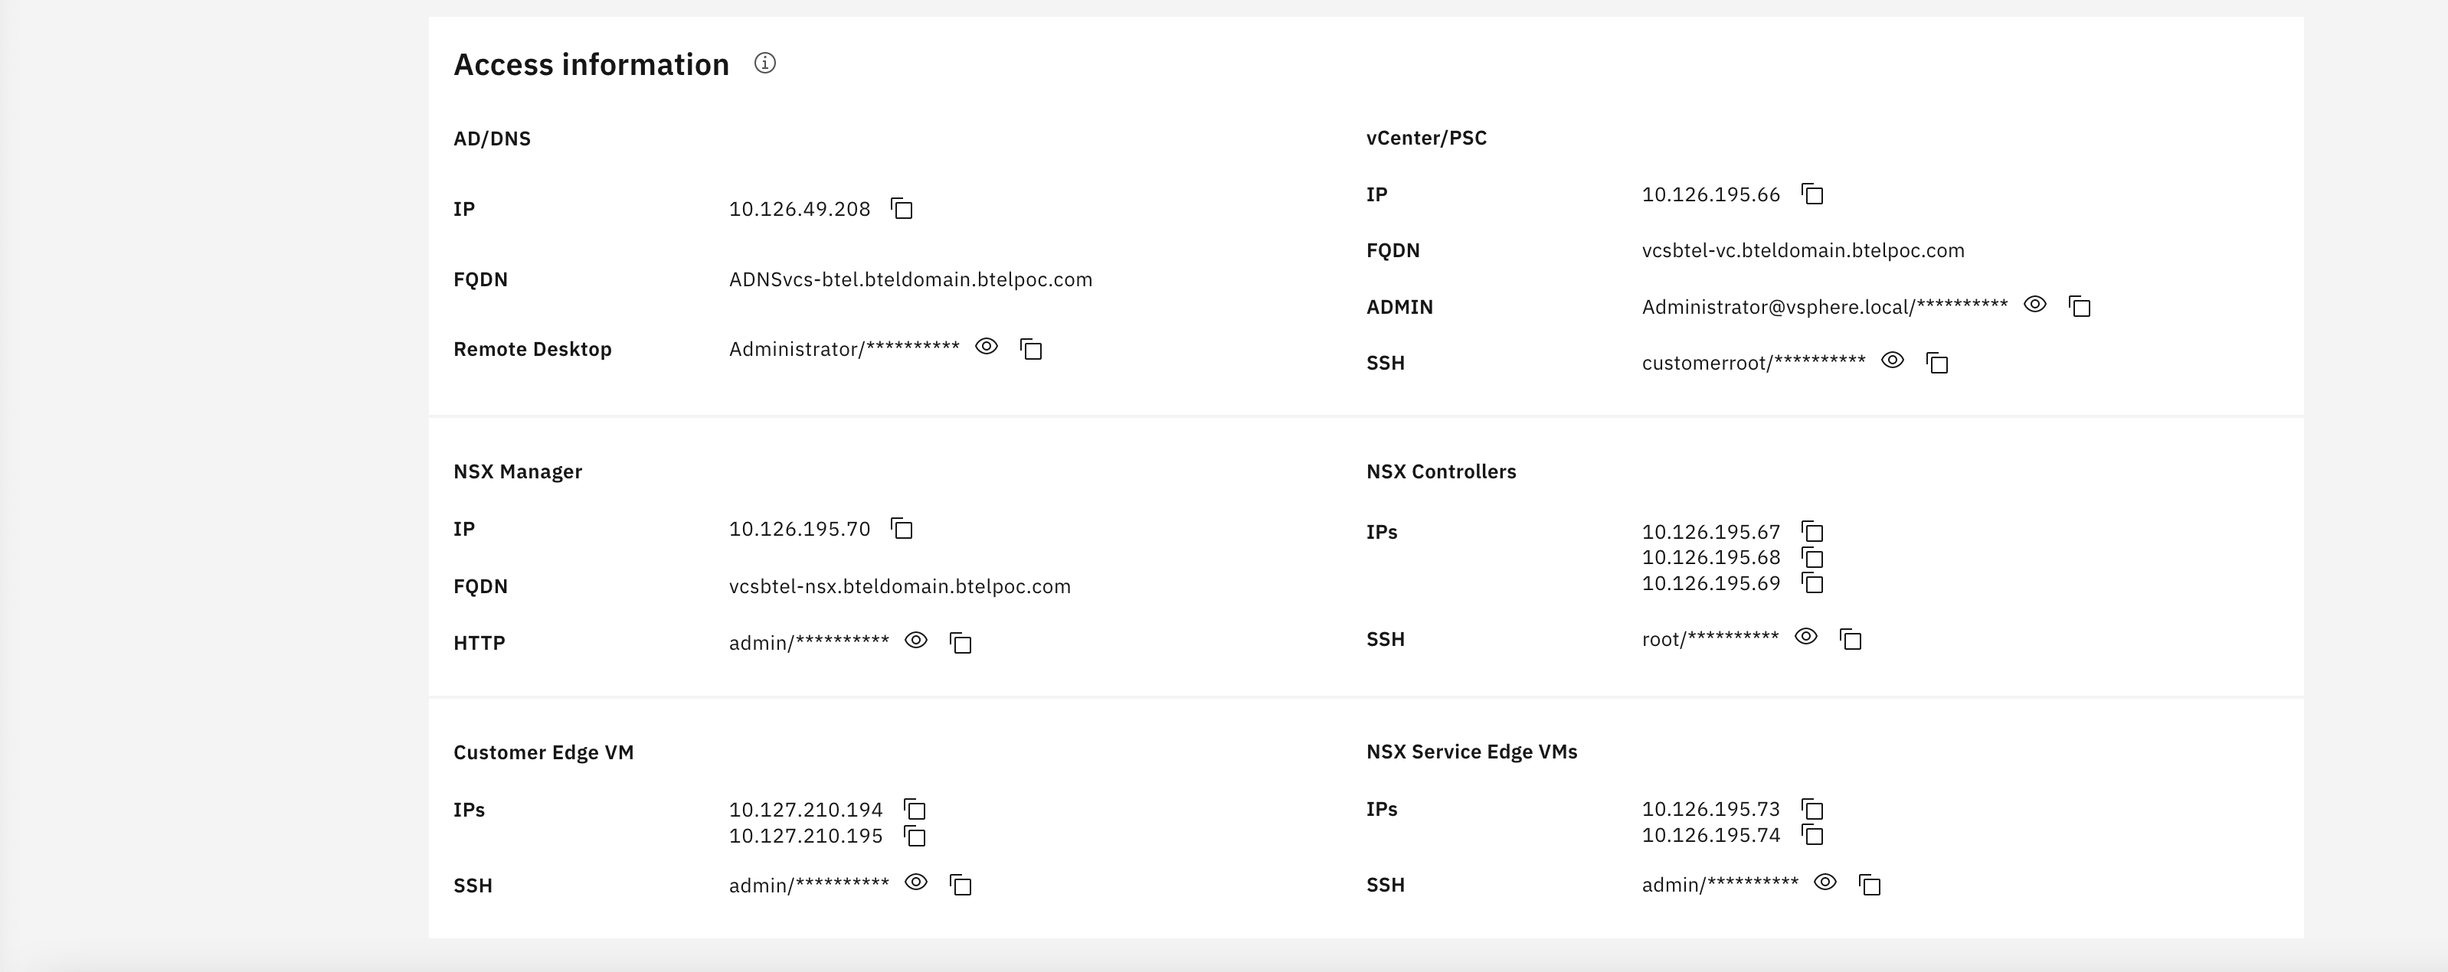
VCS Cluster Information

Slide 5
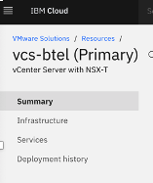
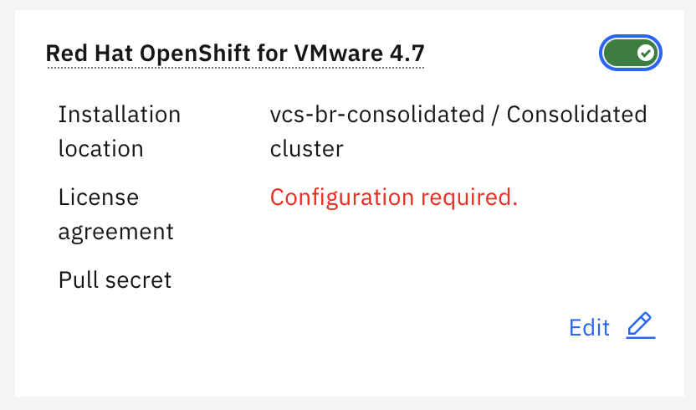
OpenShift Installation/Update on VCS Cluster 1/2
2. switch on OpenShift option
1. Click on Services and Add a service
3. Edit Configuration panel

Slide 6
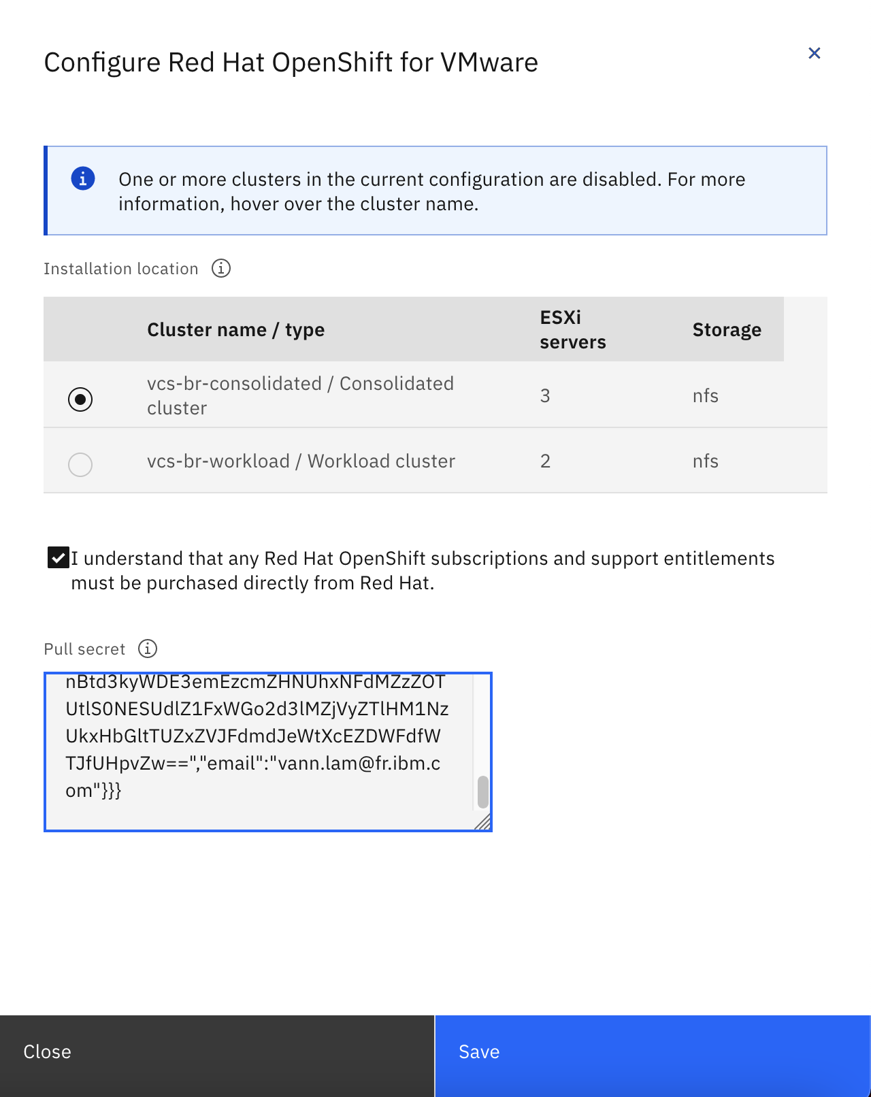
OpenShift Installation/Update on VCS Cluster 2/2
(*) Pull Secret = Red Hat OpenShift Subscription
1. Choose either management or workload cluster
2. Paste your pull secret (*)
cf. following slides, how to retrieve your pull secret
3. Save & Deploy your VCS cluster as usual

Slide 7
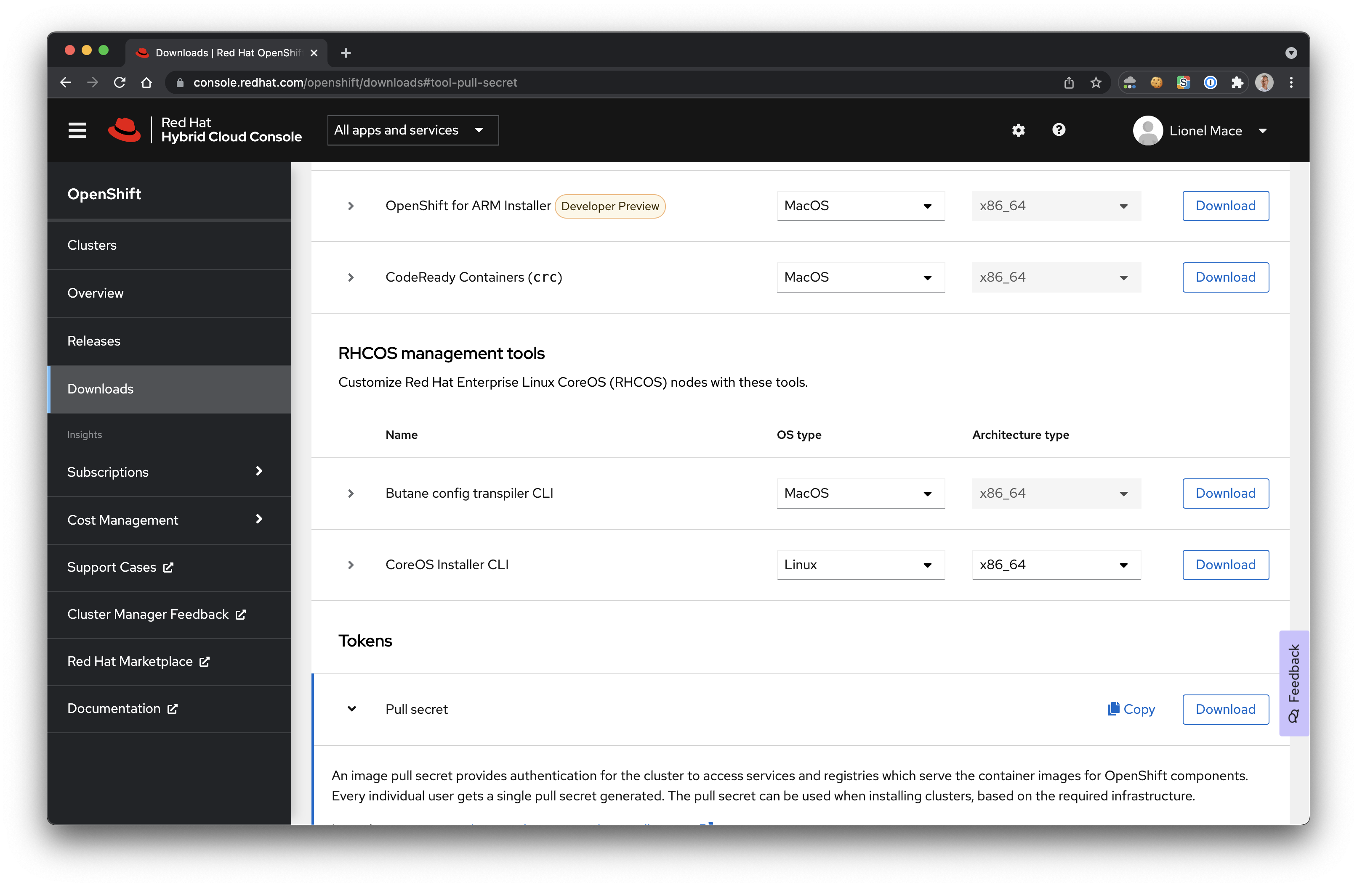
Retrieve your OpenShift subscription to pass into the Pull Secret
1. Log into your Redhat account
2. Select Downloads
3. Scroll down
4. Retrieve your Pull Secret
https://console.redhat.com/openshift

Slide 8
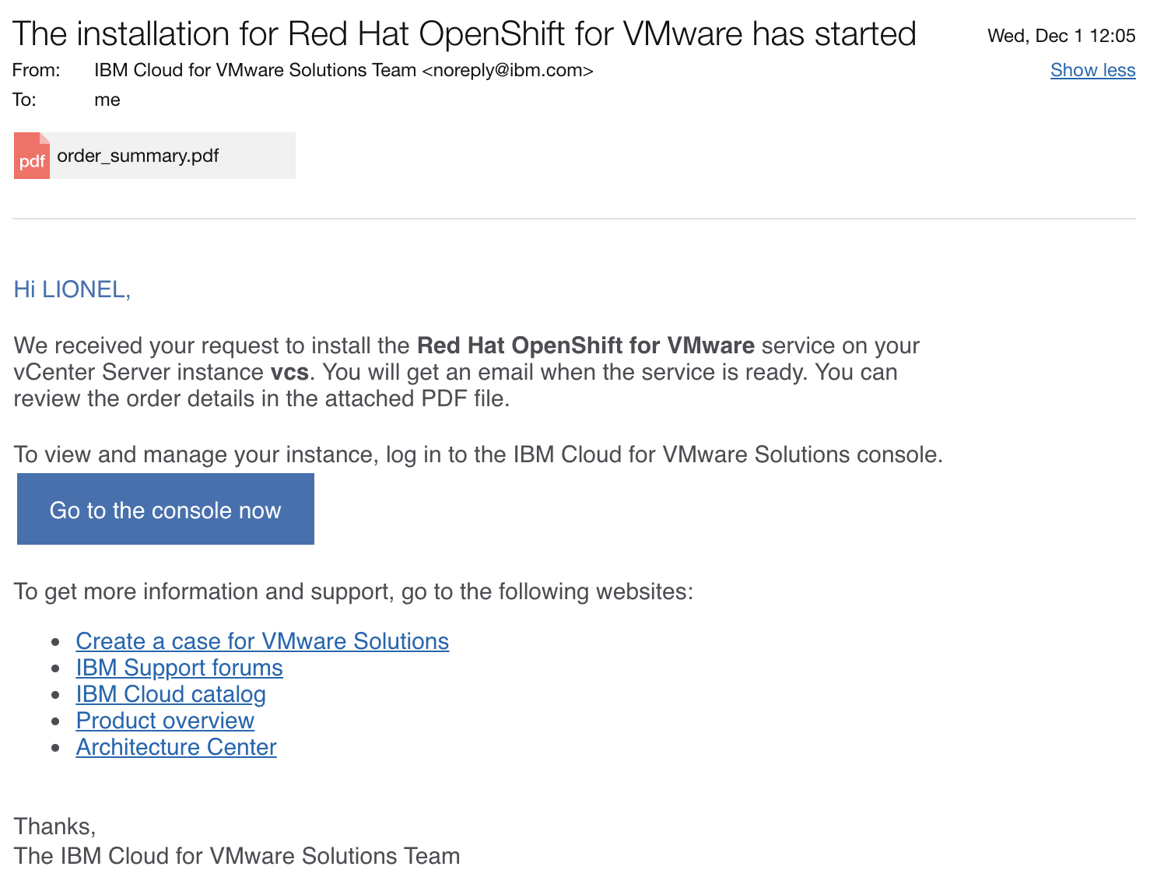
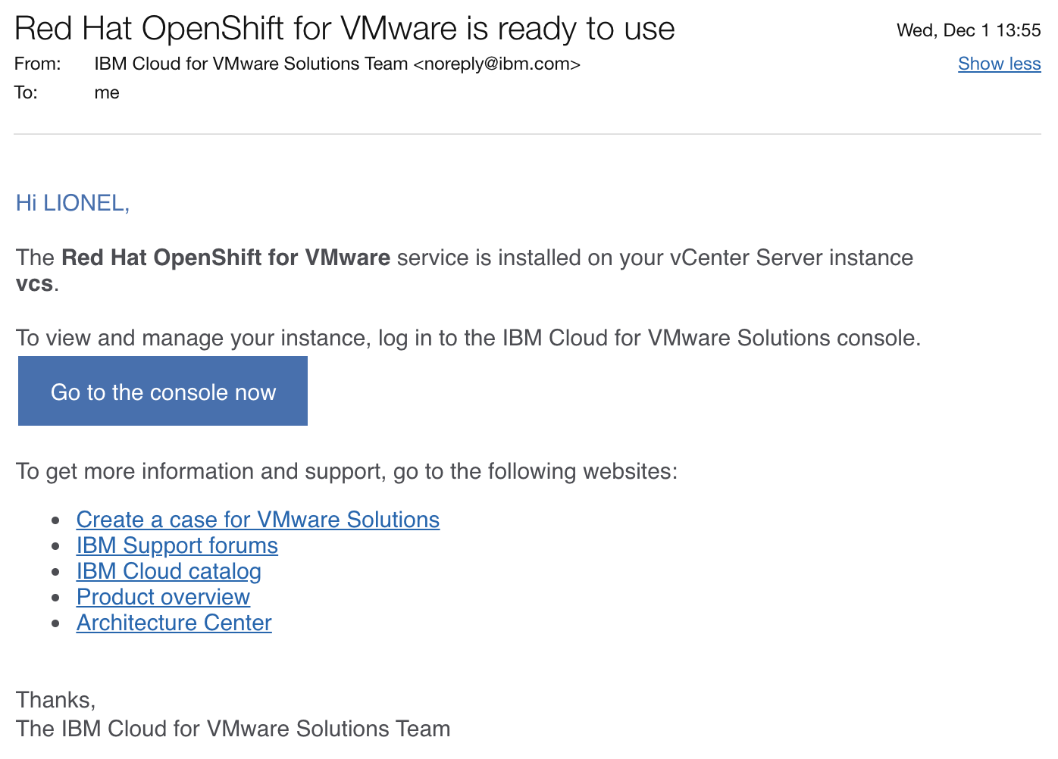
Email confirmation: OpenShift is ready to use

Slide 9
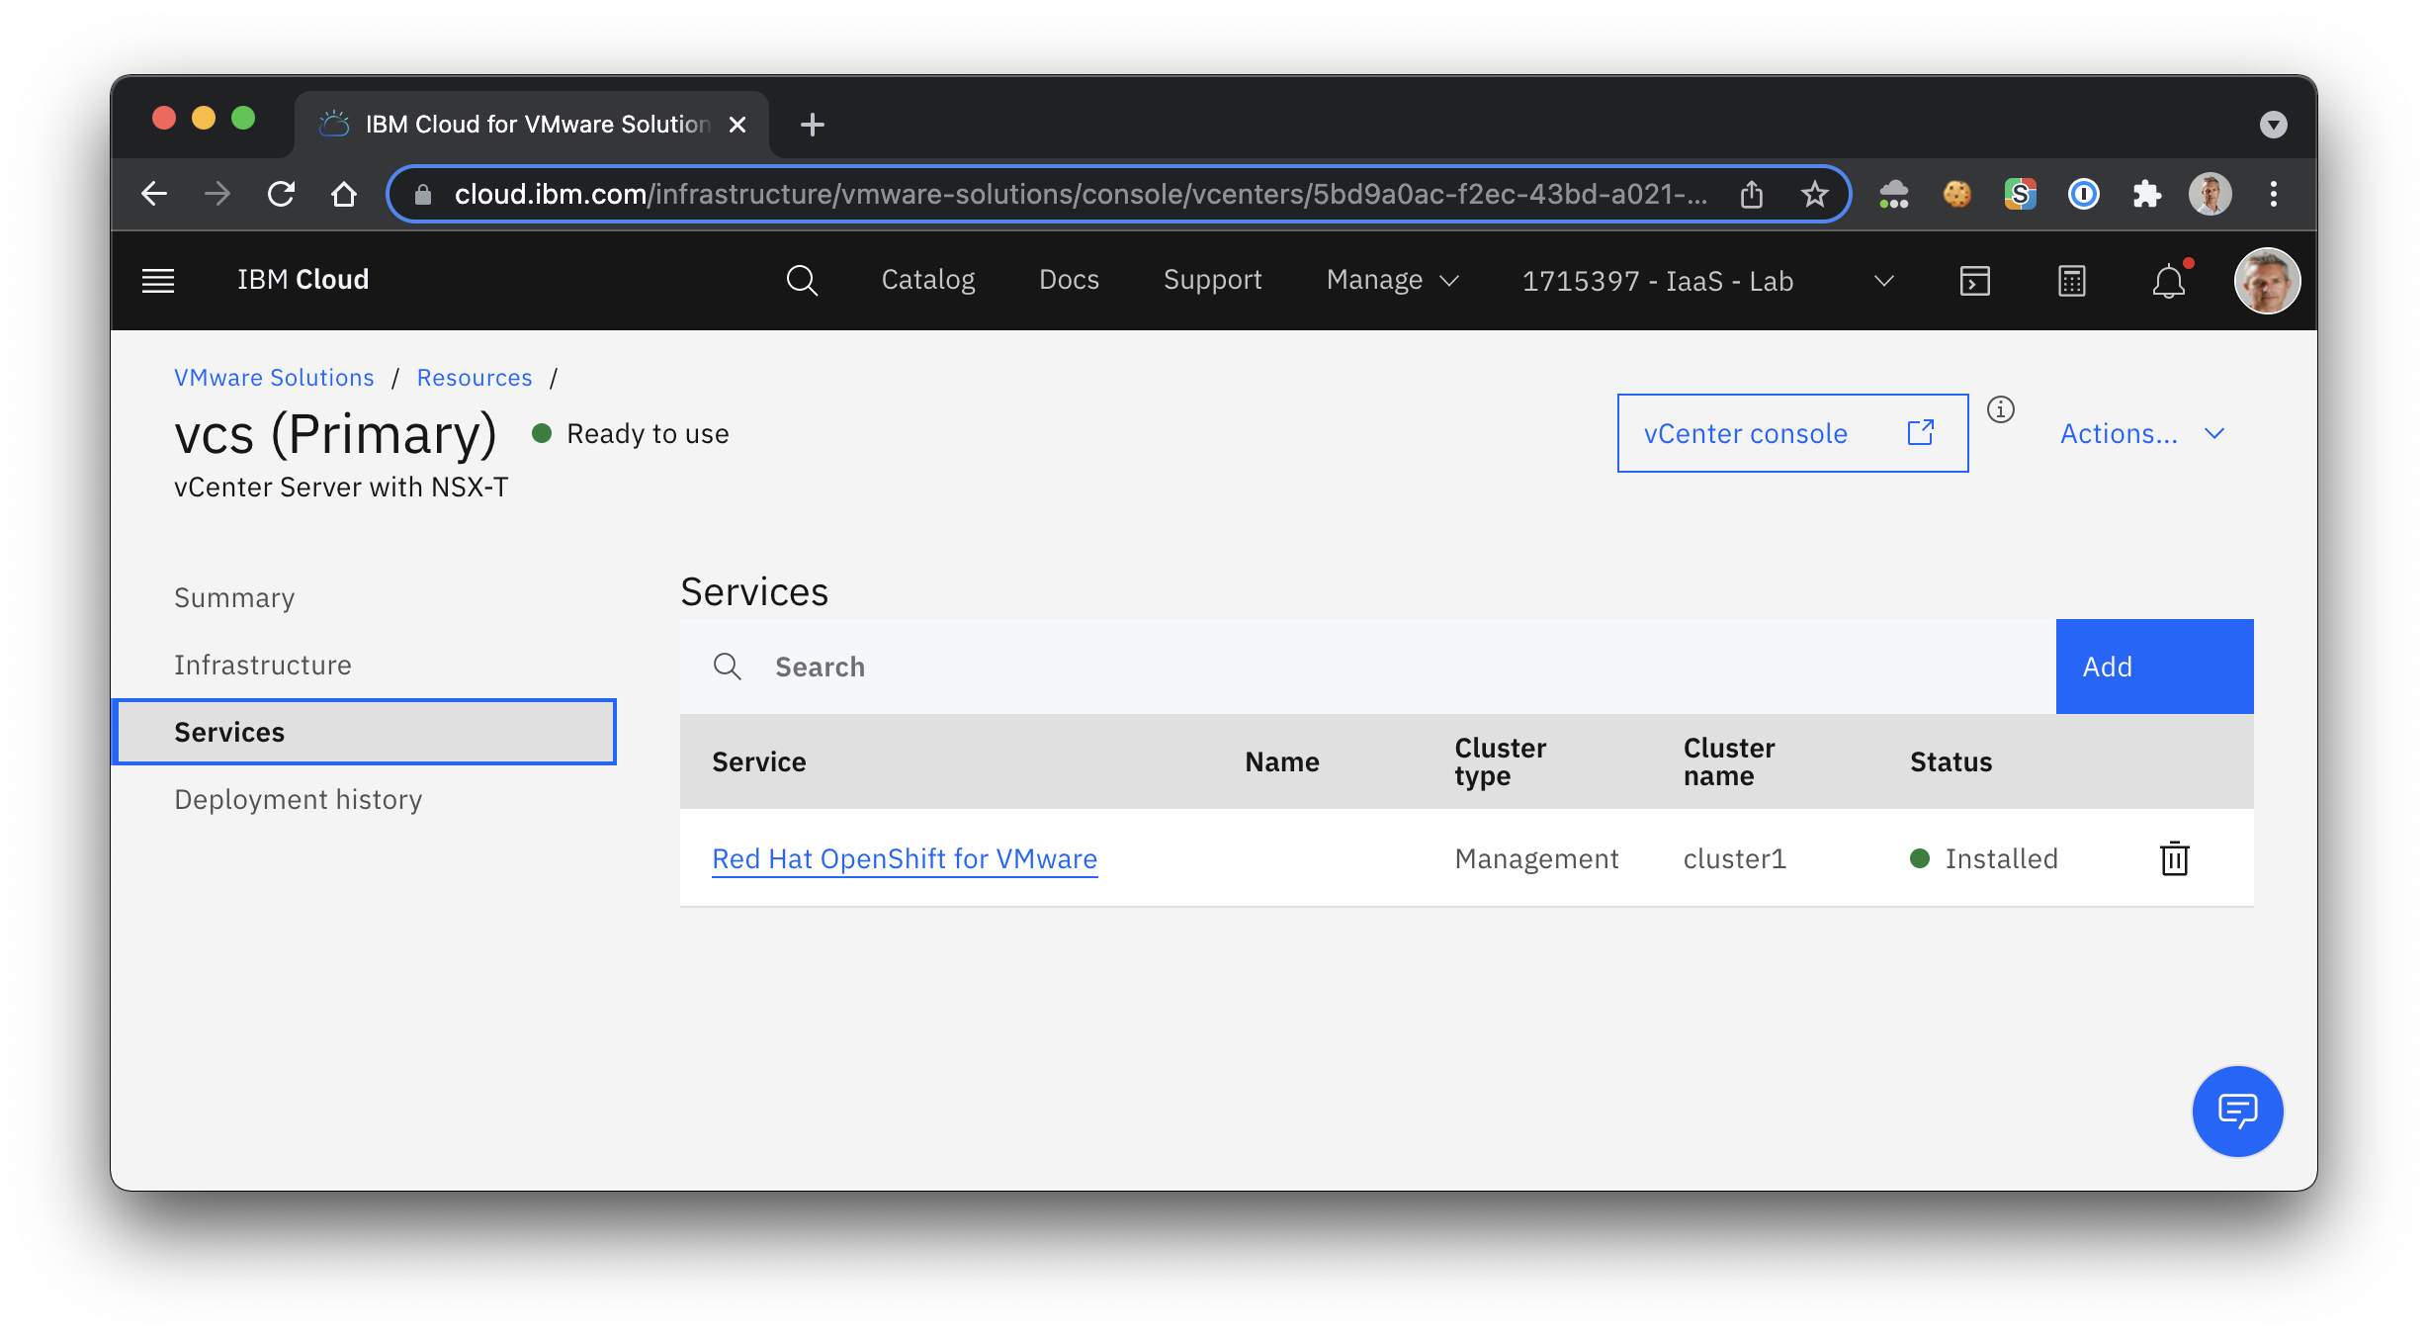
After installation, Service appears in the list of Services

Slide 10
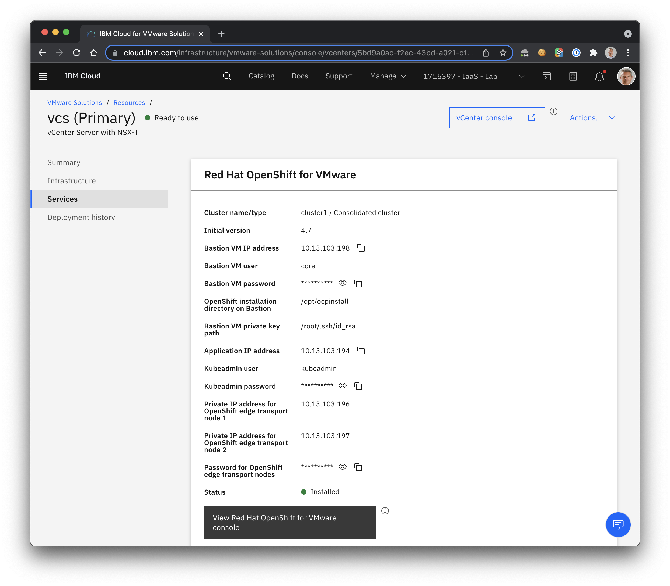
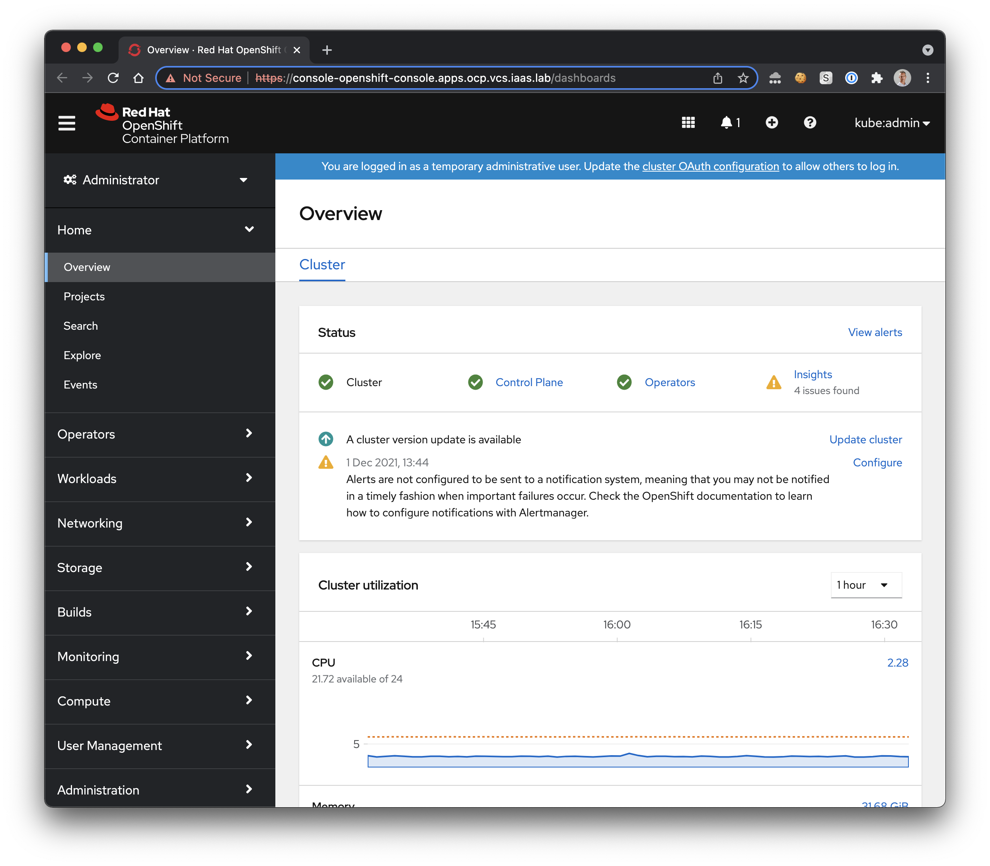
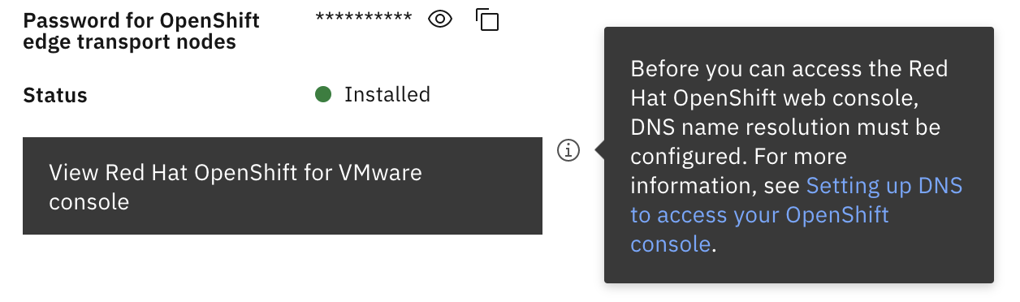
How to access OpenShift console for VMWare

Slide 11
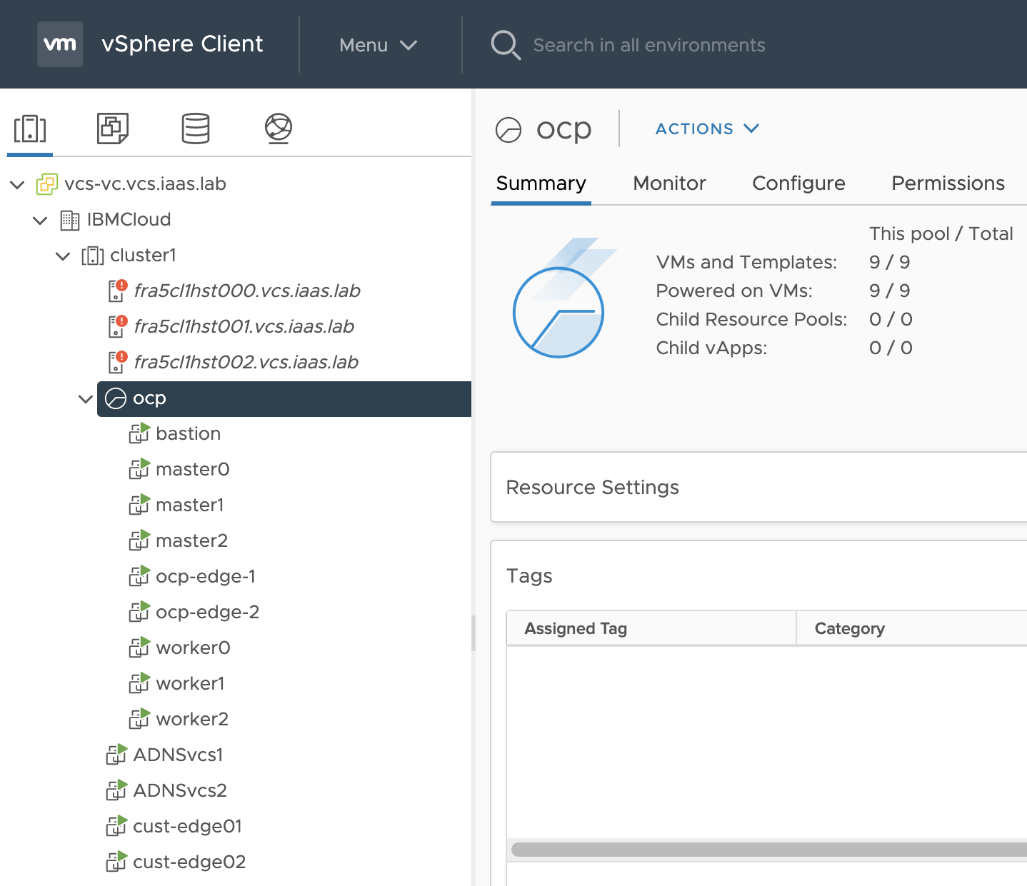
What has been automatically installed in vSphere?
7 Virtual Machines under the ocp folder:
bastion : a linux VM with pre-installed OpenShift Command line oc
3 master nodes: master0, master1, master2
3 worker nodes: worker0, worker1, worker2
2 edge nodes for your private entrypoints
All those VMs are only accessible from the private network. Either through DirectLink or VPN

Slide 12
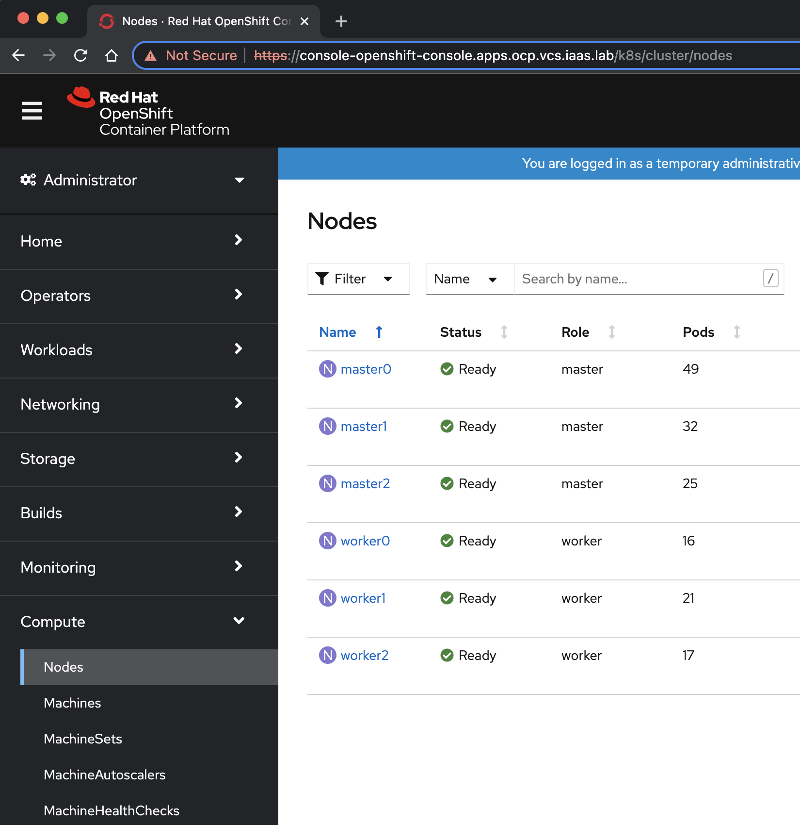
OpenShift nodes deployed
3 masters nodes
3 workers nodes

Slide 13
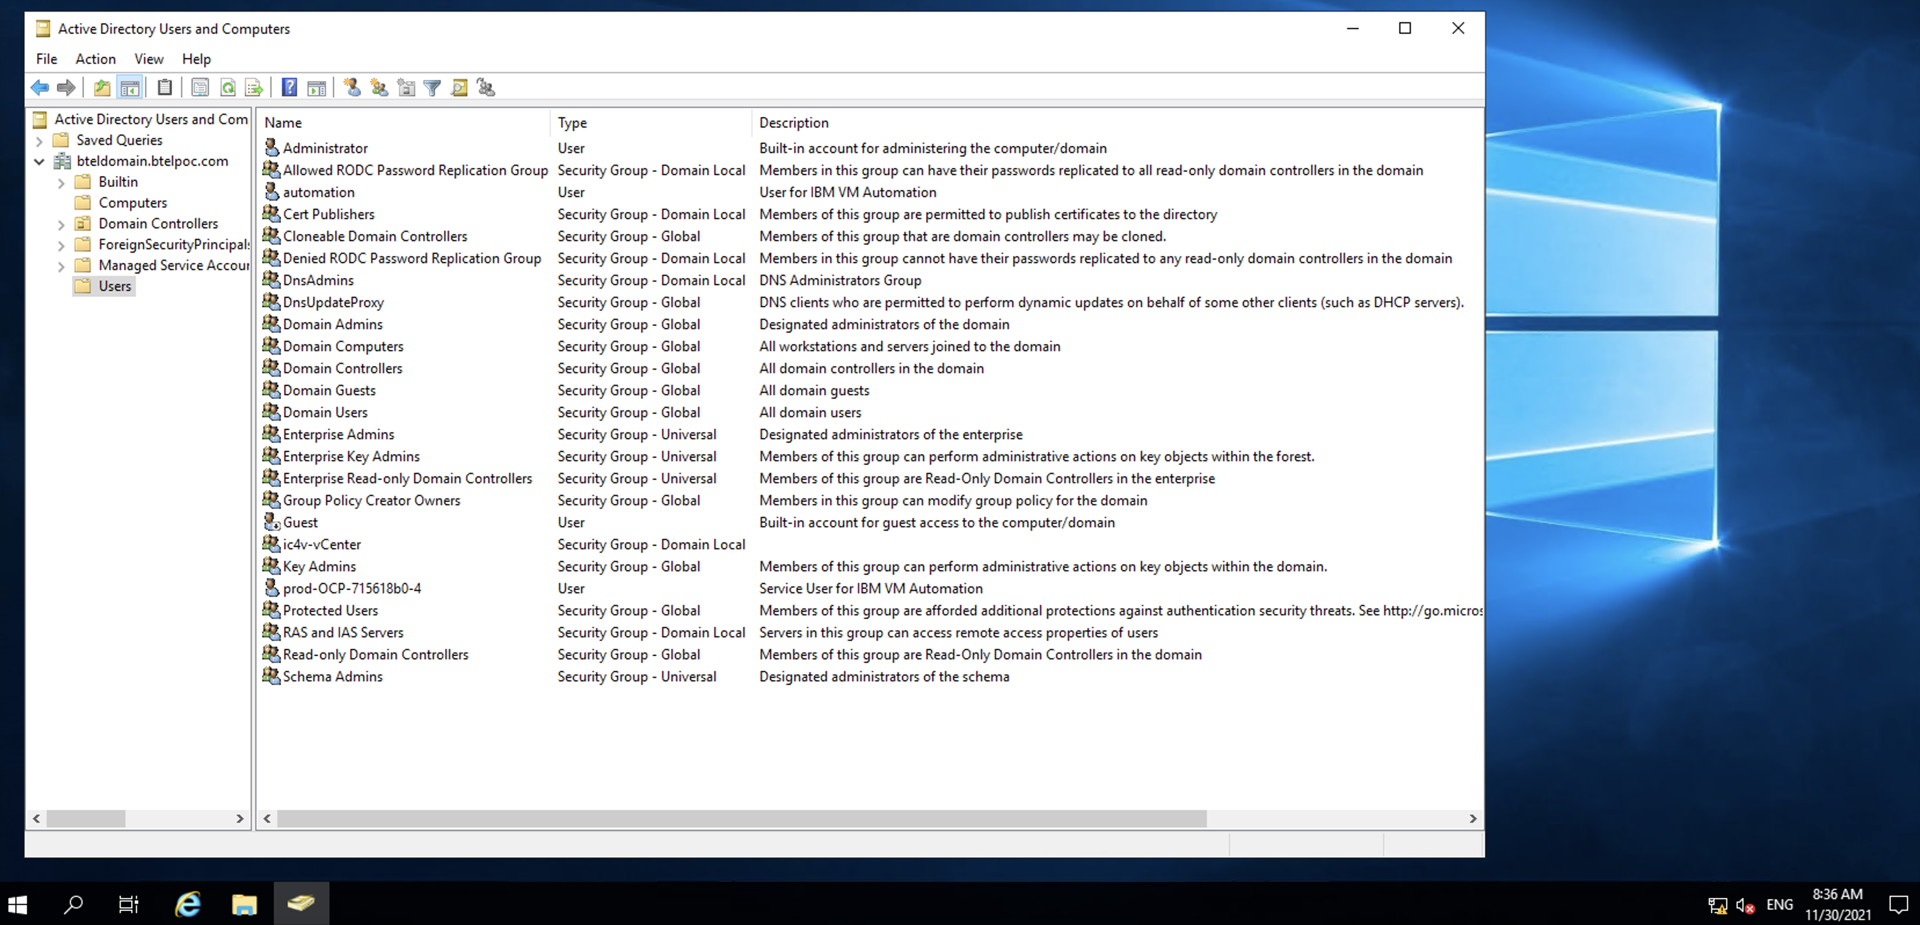
Active Directory created with your VCS
An Active Directory (AD) VM is also provided with you VCS cluster to manage your user’s access

Slide 14
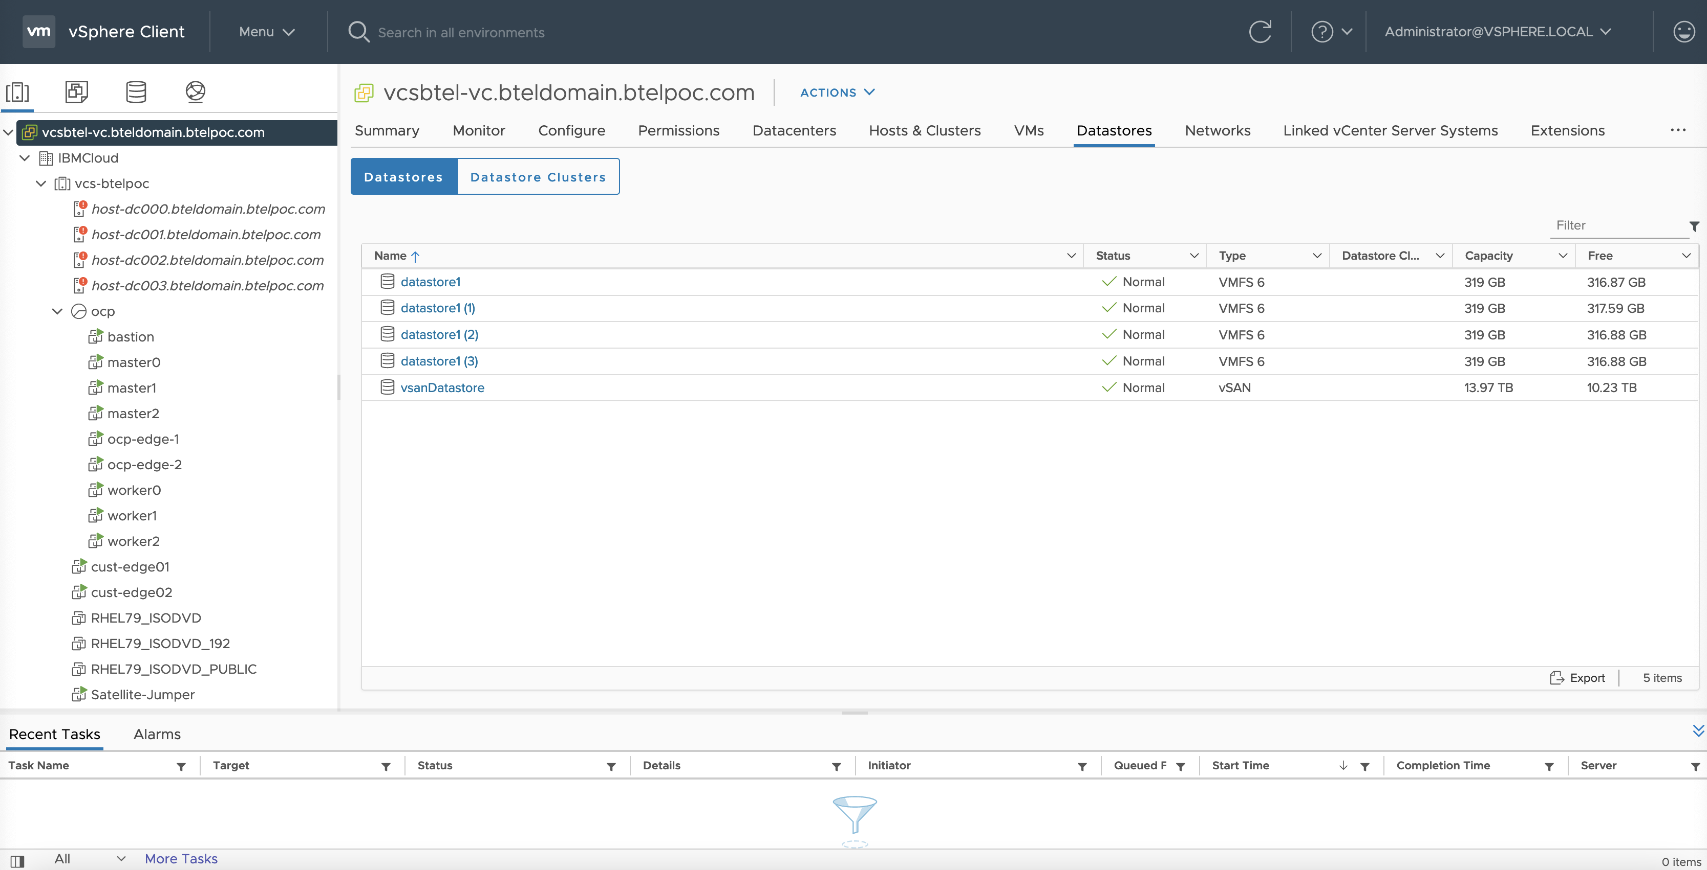
Cust-Edges created with your VCS
Two cust-edge 1 & 2 VMs for High Availability are provided along with the VCS cluster used for public application entrypoints

Slide 15
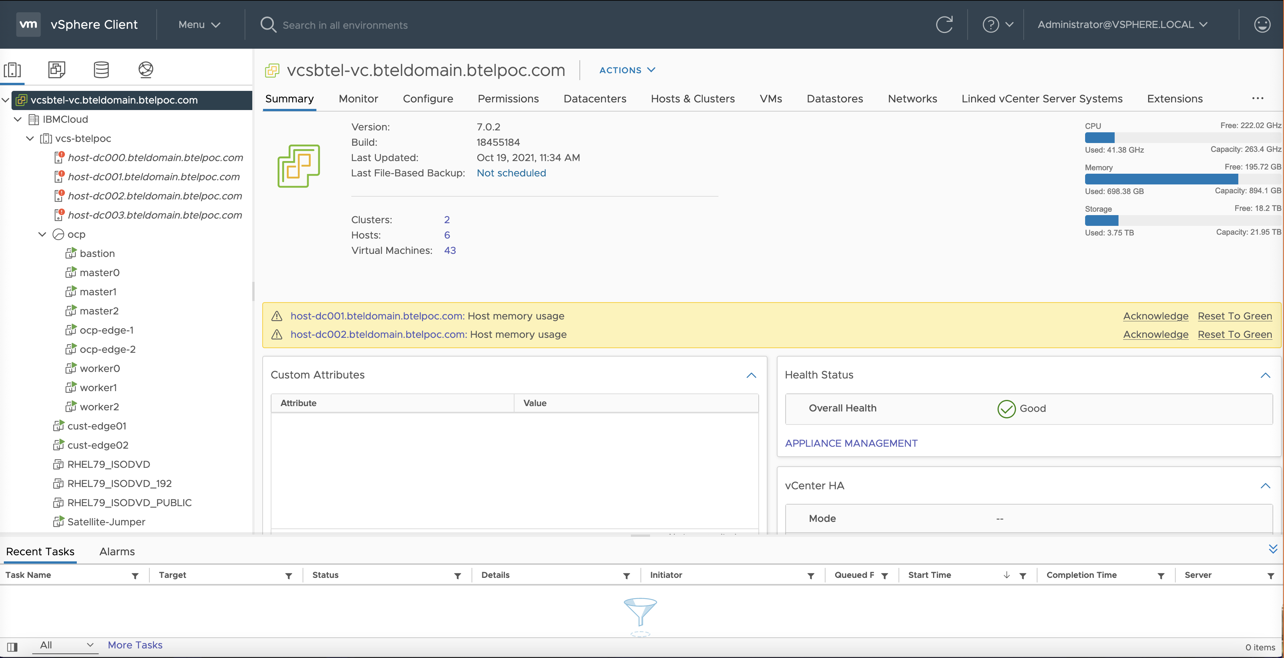
vSPhere: Baremetals and VMs

Slide 16
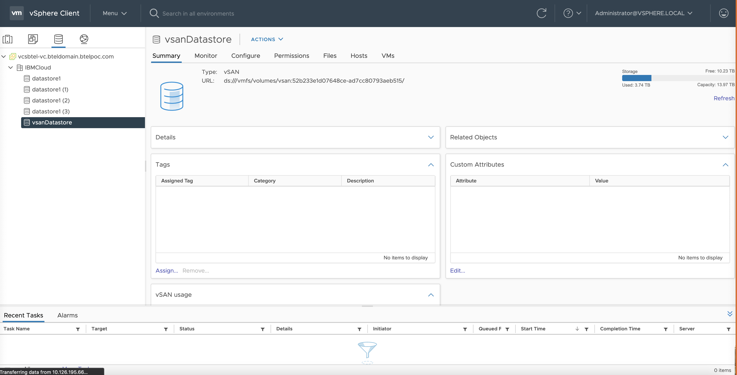
vSphere view : Datastores (VSAN as well)

Slide 17
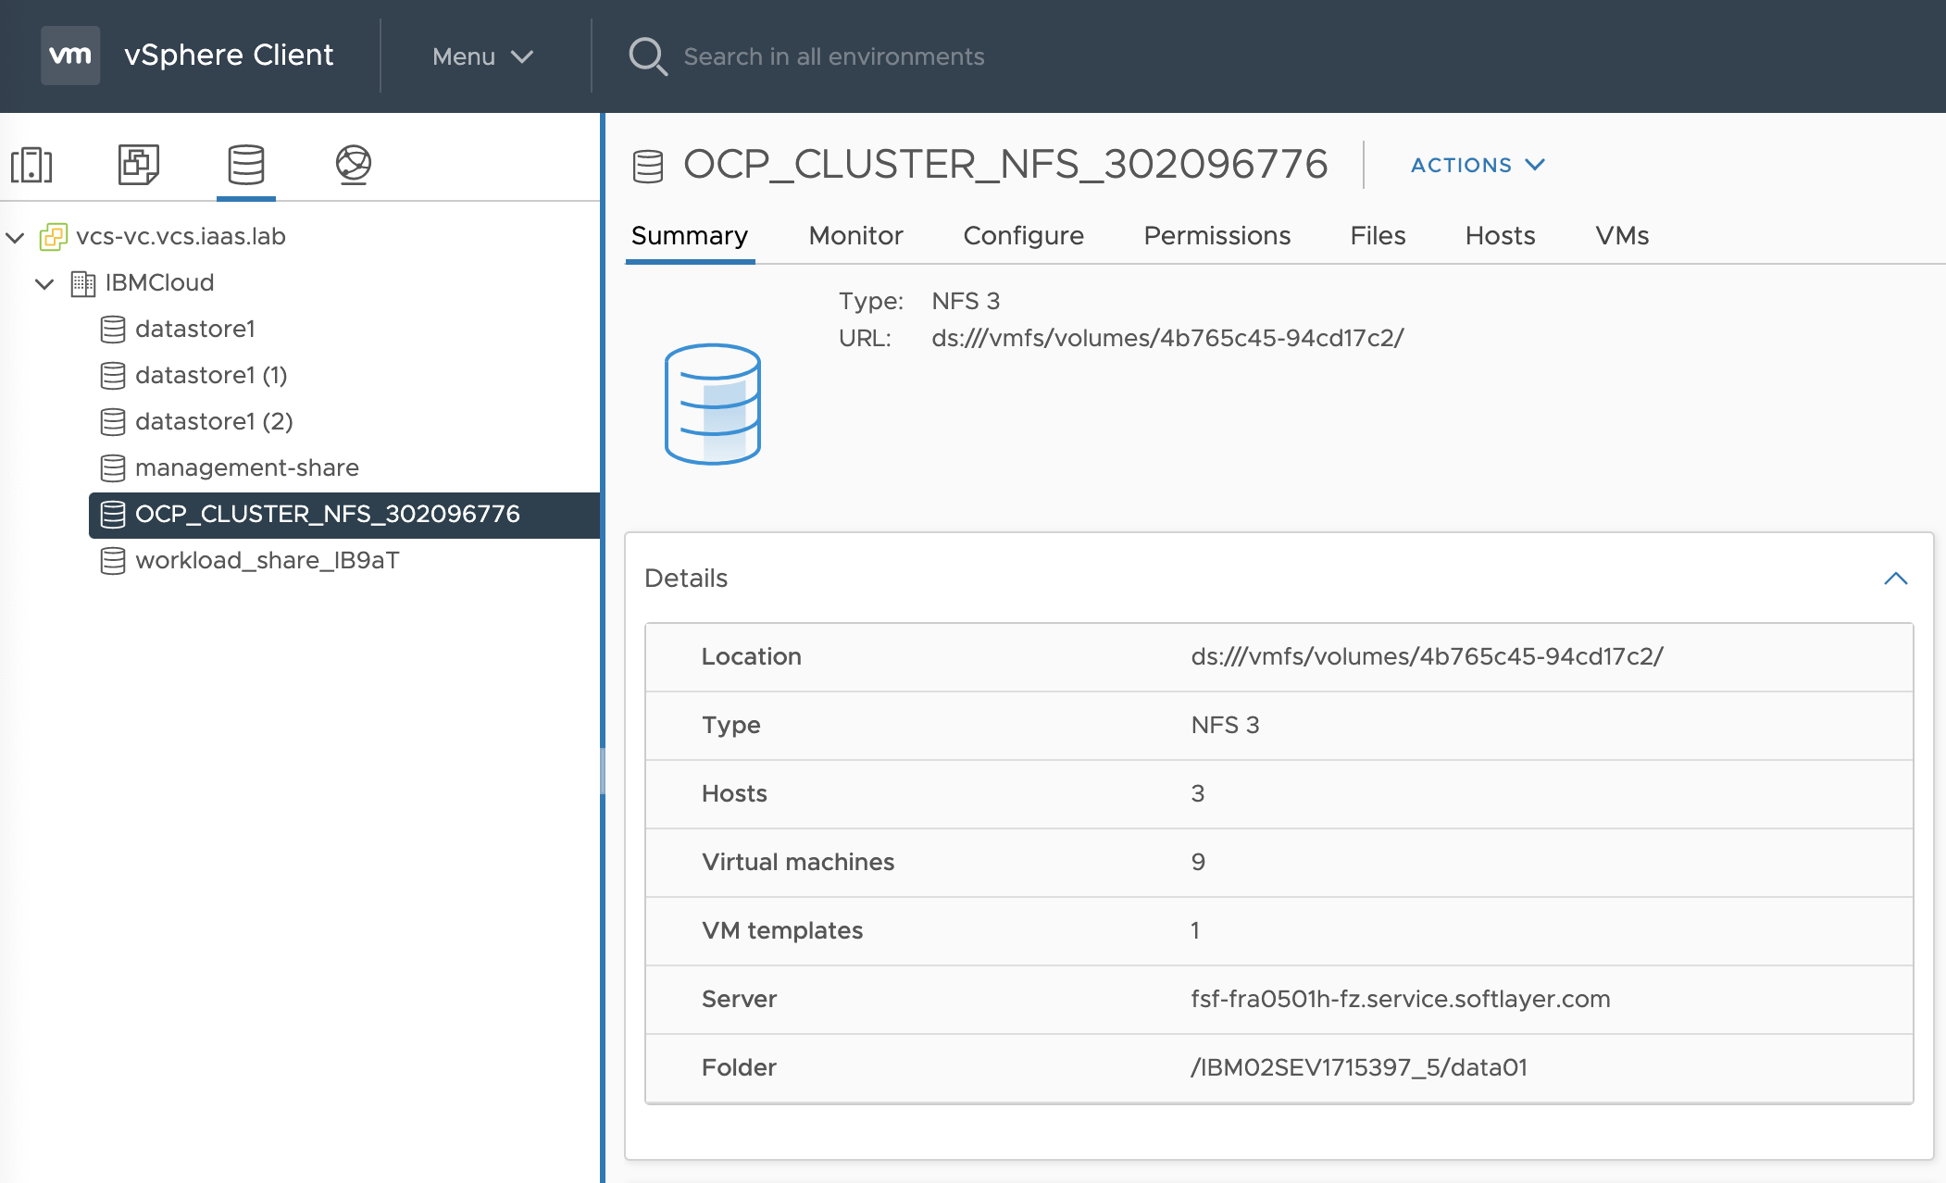
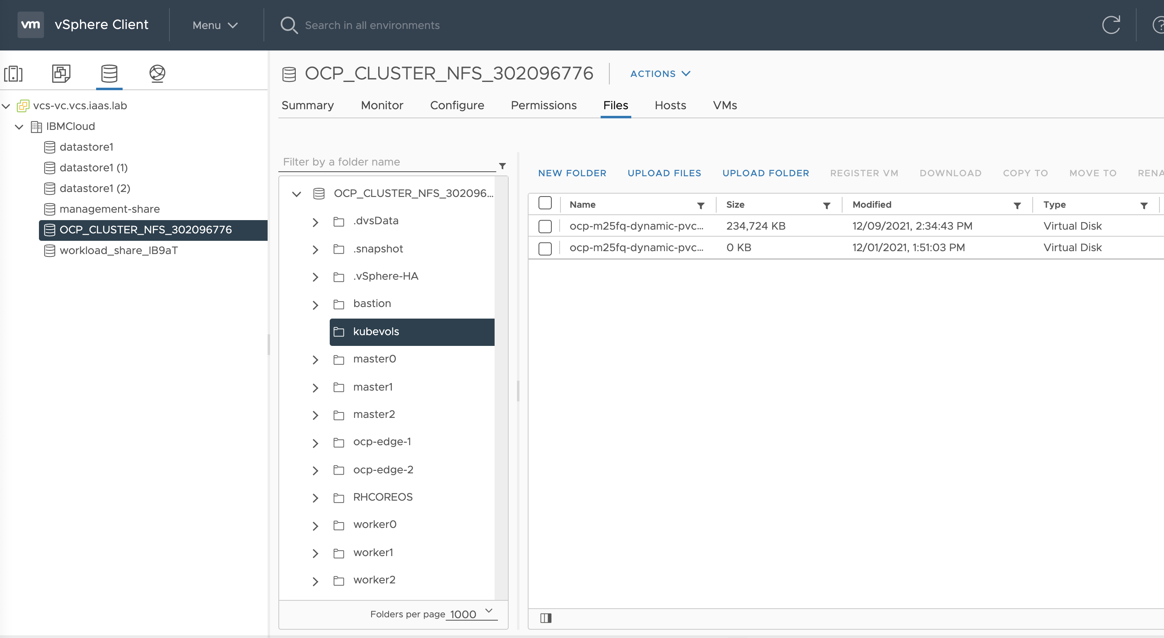
vSphere view : Datastores
VMDKs are created inside a folder named kubevols in the datastore which is mentioned in the vsphere.conf vSphere Cloud Provider configuration file.

Slide 18
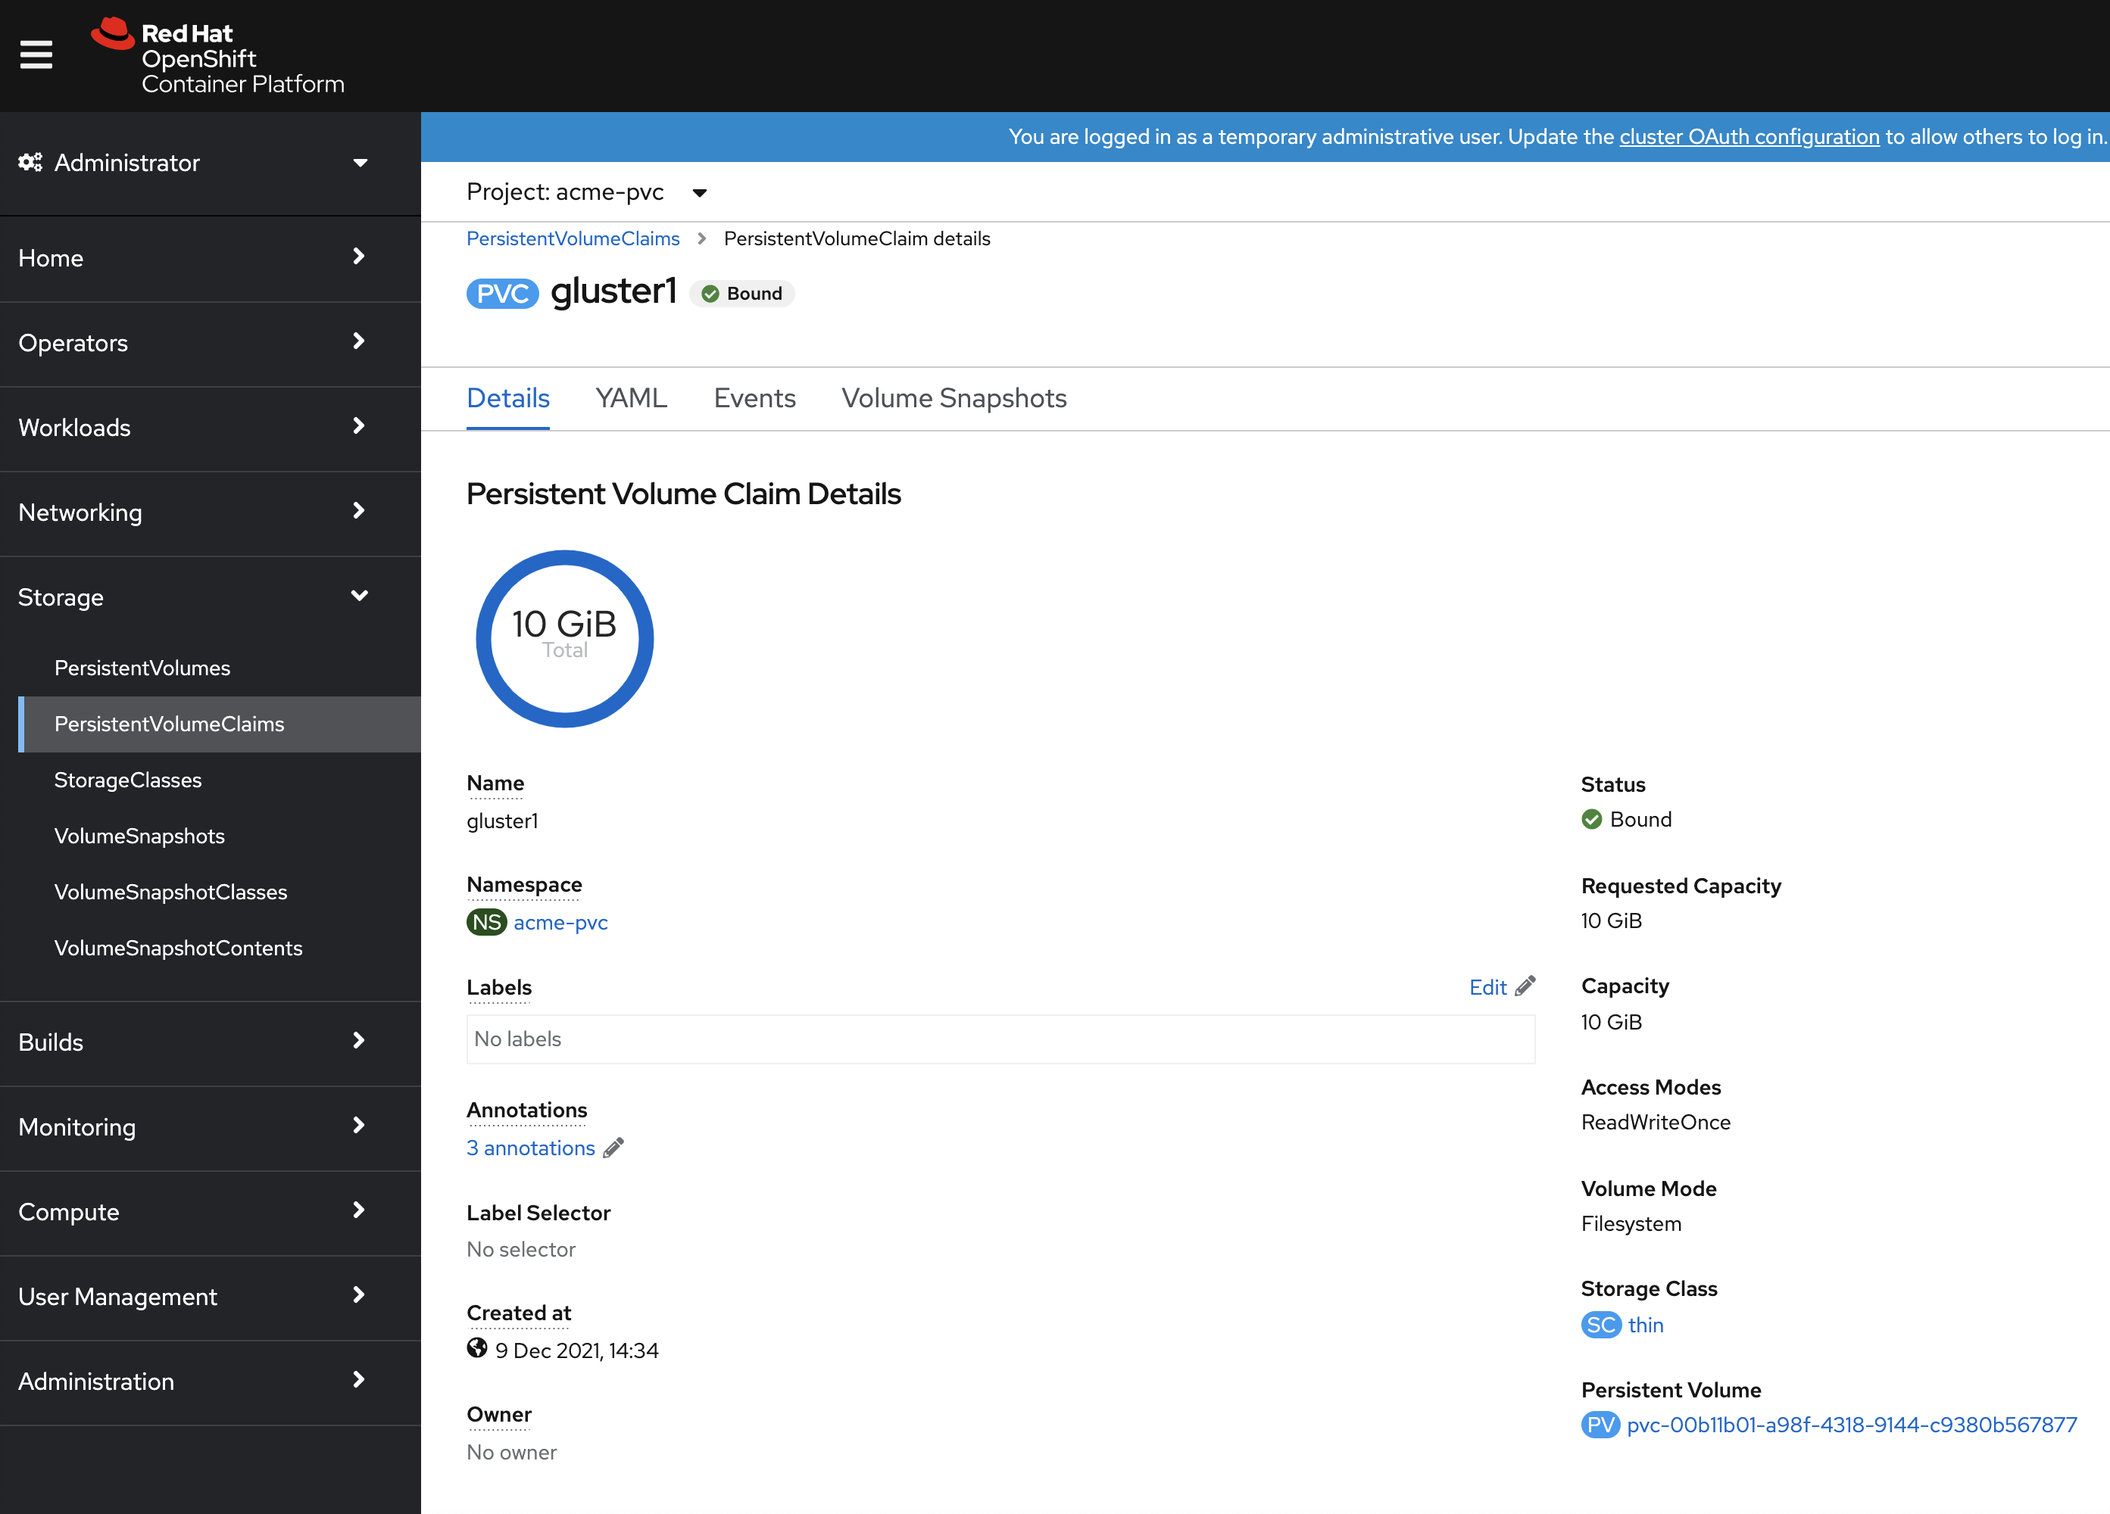
vSphere view : Datastores

Slide 19
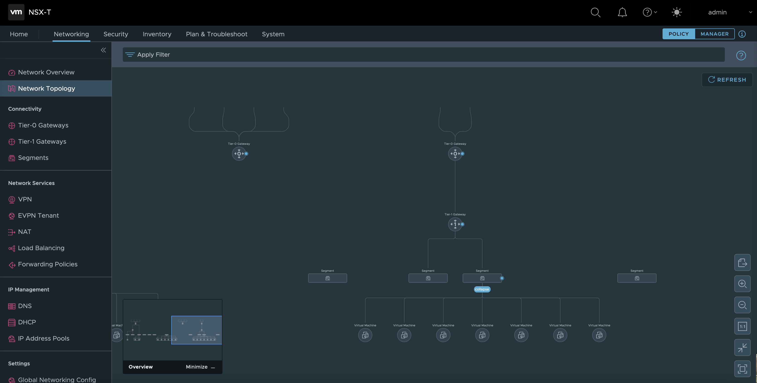
NSX-T Topology Overview

Slide 20
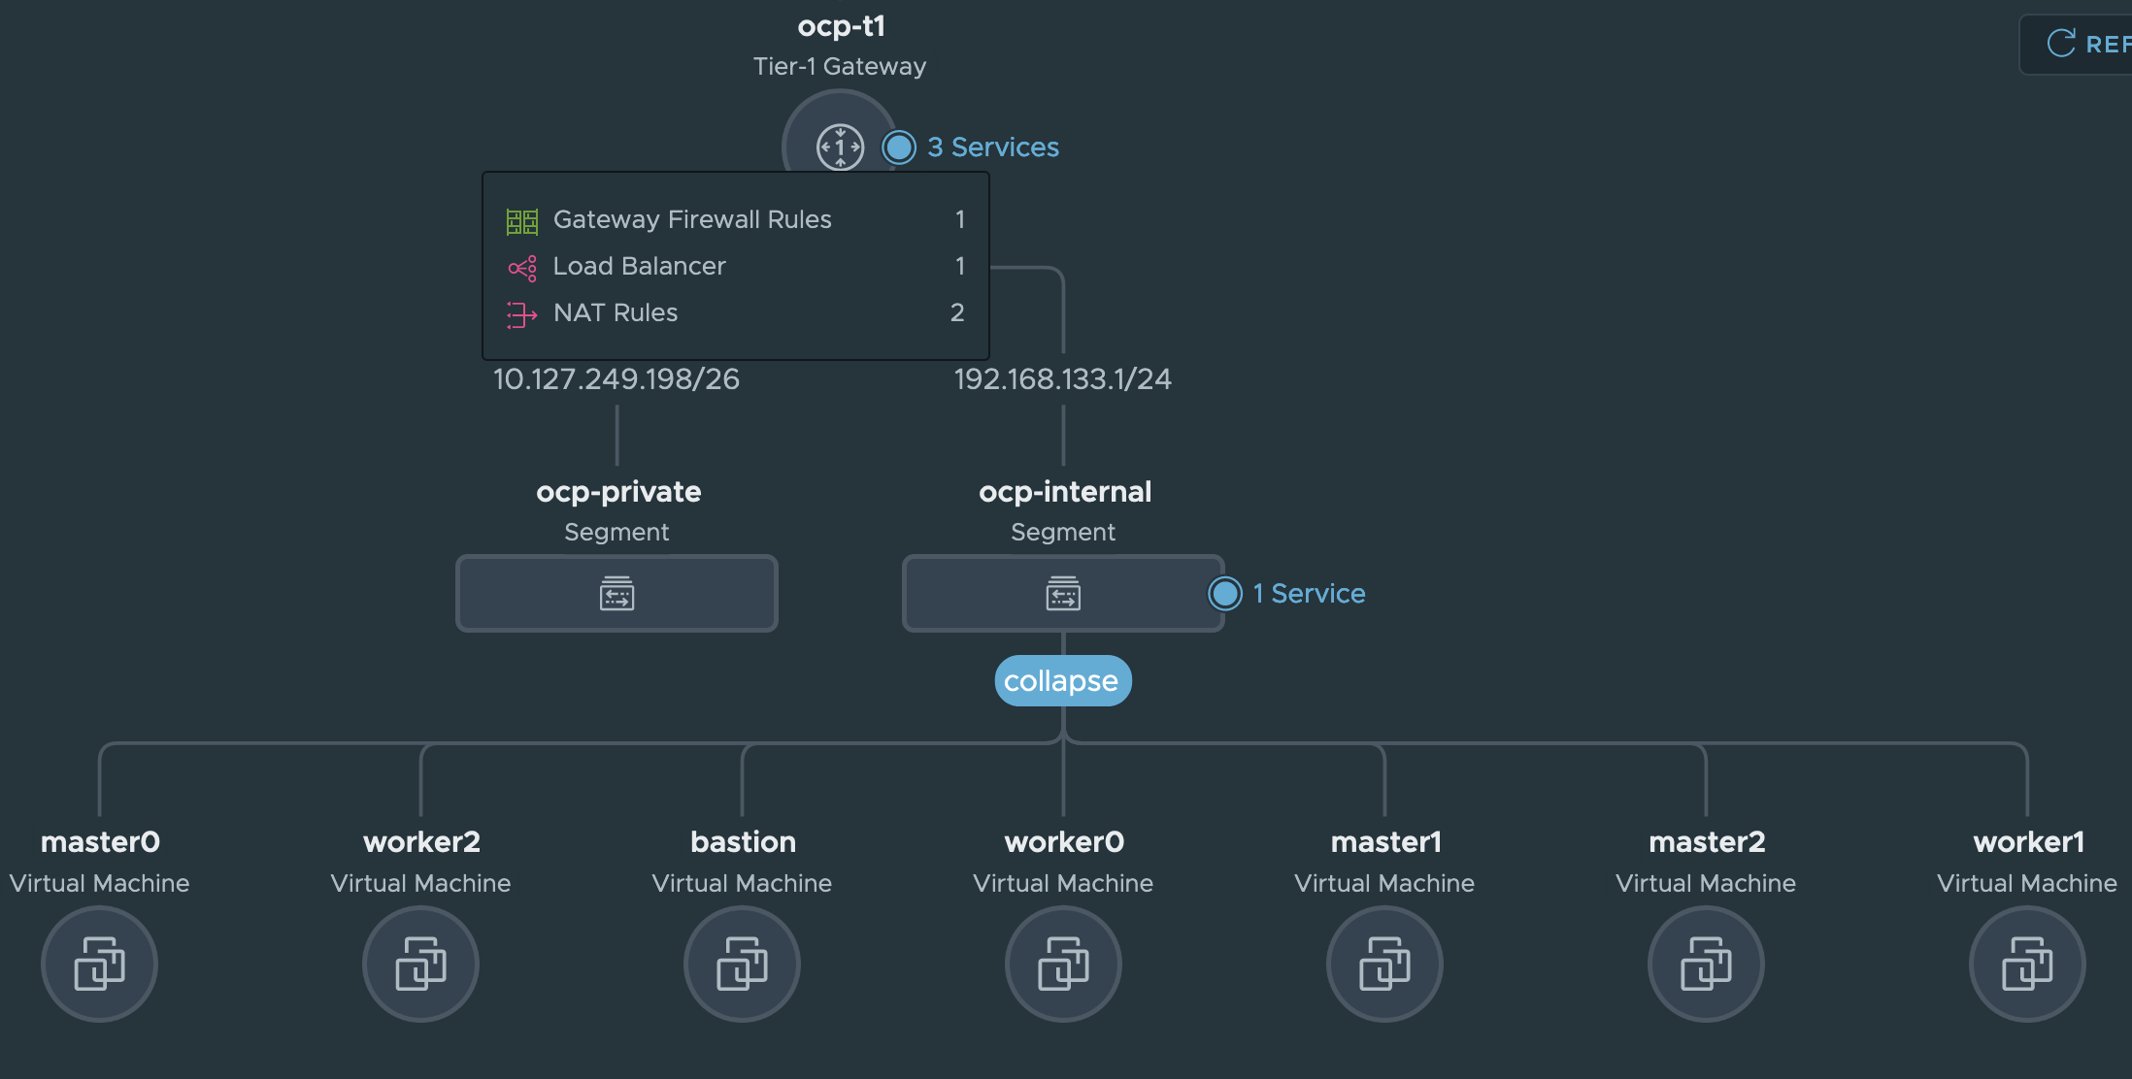
NSX-T Topology Overview
OCP Topology
1 VM Bastion
3 VM Masters
3 VM Workers

Slide 21
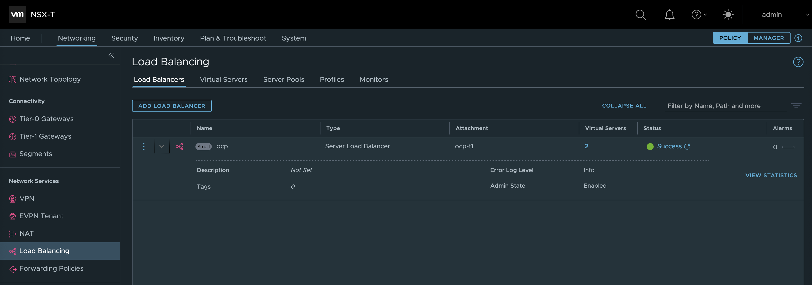
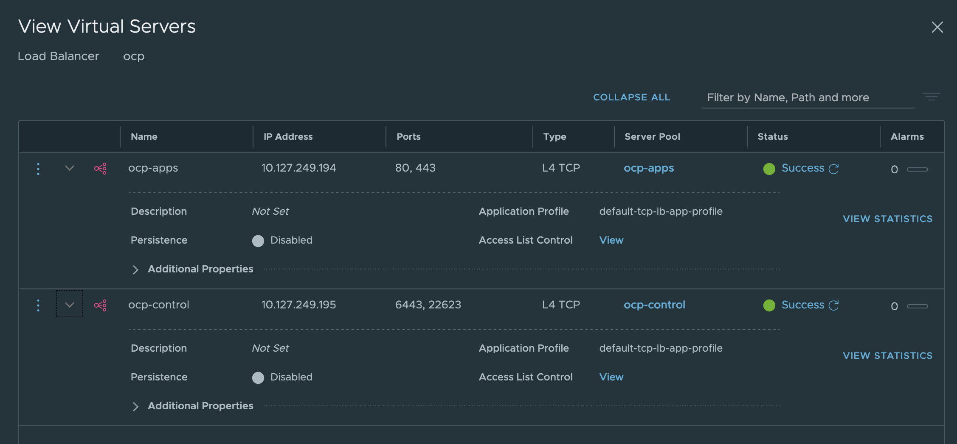
NSX-T OCP private Load balancer view

Slide 22
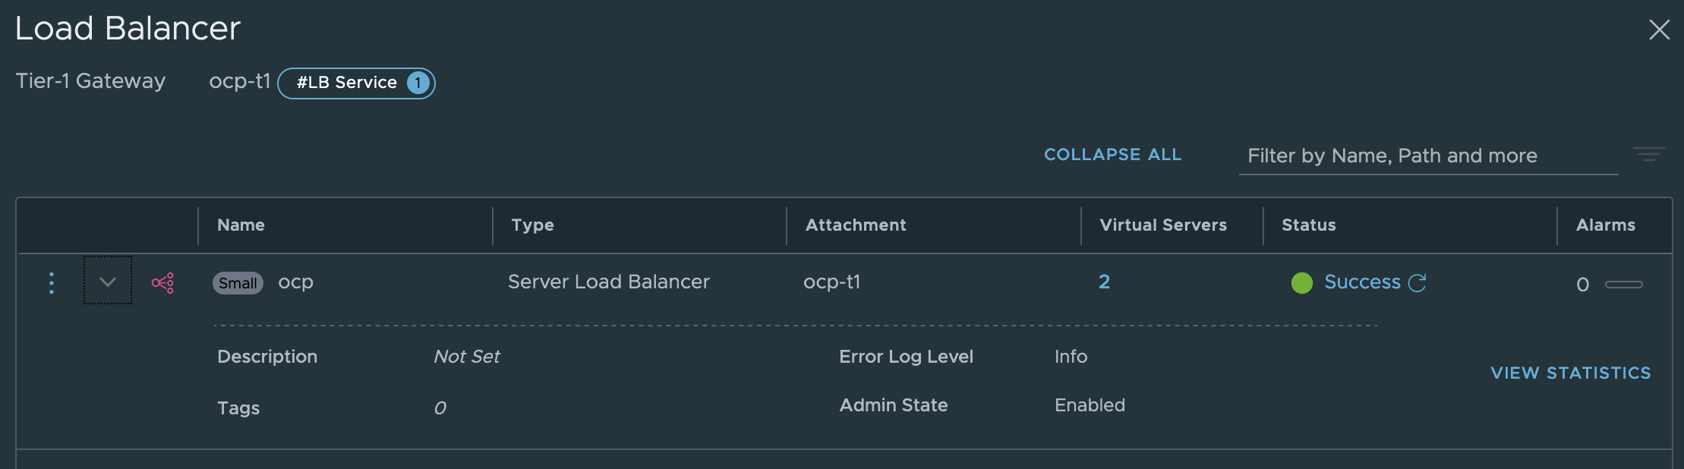
NSX-T Application Load Balancer

Slide 23
OCS on VCS : limitation as of December 2021
Automate OCS provision on VCS is limited to one cluster
Adding a worker node is manual, no documentation is provided yet
When a Kubernetes service of type LoadBalancer is created, the default Application Load balancers are used, they are based on two edge VMs handled by NSX as a service, for scability purpose, other NSX load balancer services may be created, but it is a manual process, and reconfiguration is to be done at OCP level to pointed out to these new load balancers
No NSX micro-segmentation is implemented on pods
Competing against Tanzu : be aware that the limitations above could be a show stopper, Vmware claims that Tanzu has way more integration with NSX than OCP could have

